Slide 1
Human Computer Interaction
The computer part VI
PHYSICAL CONTROLS, SENSORS AND SPECIAL DEVICES
CS 8th Semester

Slide 2
PHYSICAL CONTROLS, SENSORS AND SPECIAL DEVICES
Computers are coming out of the box.
The mouse keyboard and screen of the traditional computer system are not relevant or possible in applications that now employ computers such as interactive TV, in-car navigation systems or personal entertainment.
These devices may have special displays, may use sound, touch and smell as well as visual displays, may have dedicated controls and may sense the environment or your own bio-signs.

Slide 3
dedicated displays
analogue representations:
dials, gauges, lights, etc.
digital displays:
small LCD screens, LED lights, etc.
head-up displays
found in aircraft cockpits
show most important controls … depending on context

Slide 4
PHYSICAL CONTROLS, SENSORS AND SPECIAL DEVICES
Following are the famous Physical Controls, Sensors and Special Devices
Sound Output
Touch, Feel and Smell
Physical Controls
Environmental And Bio-sensing

Slide 5
Sounds
Computer based Products Beeps, bongs, clonks, whistles and whirrs and even talks like in case of car navigation system
Examples
1. used for error indications
2. confirmation of actions e.g. keyclick

Slide 6
Sound Output
A mode of output that we should consider is that of auditory signals.
These are Often designed to be used in conjunction with screen displays, auditory outputs are poorly understood: we do not yet know how to utilize sound in a sensible way to achieve maximum effect and information transference.
We have discussed speech previously, but other sounds such as beeps, bongs, clanks, whistles and whirrs are all used to varying effect. As well as conveying system output, sounds offer an important level of feedback in interactive systems.

Slide 7
Touch, feel, smell
touch and feeling important
in games … vibration, force feedback
in simulation … feel of surgical instruments
called haptic devices
texture, smell, taste
current technology very limited

Slide 8
Touch, Feel And Smell
Our other senses are used less in normal computer applications, but you may have played computer games where the joystick or artificial steering wheel vibrated, perhaps when a car was about to go off the track.
In some VR applications, such as the use in medical domains to ‘practice’ surgical procedures, the feel of an instrument moving through different tissue types is very important.
The devices used to emulate these procedures have force feedback, giving different amounts of resistance depending on the state of the virtual operation.
These various forms of force, resistance and texture that influence our physical senses are called haptic devices.

Slide 9
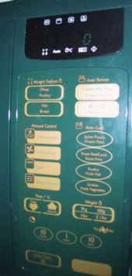
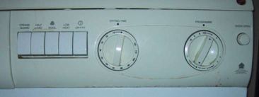
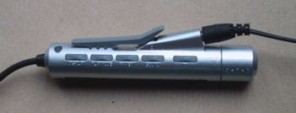
physical controls
specialist controls needed …
industrial controls, consumer products, etc.
easy-clean
smooth buttons
multi-function control
large buttons
clear dials
tiny buttons

Slide 10
Physical Controls
You can see the controls for a microwave, a washing machine and a personal Mini Disc player. See how they each use very different physical devices: the microwave has a flat plastic sheet with soft buttons, the washing machine large switches and knobs, and the Mini Disc has small buttons and an interesting multi-function end. A desktop computer system has to serve many functions and so has generic keys and controls that can be used for a variety of purposes. In contrast, these dedicated control panels have been designed for a particular device and for a single use. This is why they differ so much.
A desktop computer system has to serve many functions and so has generic keys and controls that can be used for a variety of purposes. In contrast, these dedicated control panels have been designed for a particular device and for a single use. This is why they differ so much.

Slide 11
Environment and bio-sensing
sensors all around us
car courtesy light – small switch on door
ultrasound detectors – security, washbasins
RFID security tags in shops
temperature, weight, location
… and even our own bodies …
iris scanners, body temperature, heart rate, galvanic skin response, blink rate

Slide 12
Environment and Bio-sensing
In a public washroom there are often no controls for the wash basins, you simply put your hands underneath and (hope that) the water flows. Similarly when you open the door of a car, the courtesy light turns on. The washbasin is controlled by a small infrared sensor that is triggered when your hands are in the basin (although it is sometimes hard to find the ‘sweet spot’ where this happens!). The courtesy lights are triggered by a small switch in the car door.
Although we are not always conscious of them, there are many sensors in our environment – controlling automatic doors, energy saving lights, etc. and devices monitoring our behavior such as security tags in shops. The vision of ubiquitous computing suggests that our world will be filled with such devices.
There are many different sensors available to measure virtually anything: temperature, movement (ultrasound, infrared, etc.), location (GPS, global positioning, in mobile devices), weight (pressure sensors). In addition audio and video information can be analyzed to identify individuals and to detect what they are doing. This all sounds big brother like, but is also used in ordinary applications, such as the washbasin.

